Slide 1
Comparison Between Different Approaches
HIE Challenges and Blochchain solution.
Main articles.
Comparison table.
Suitable Approach.
Limitation of selected Paper.
Proposed Solution.

Slide 2
HIE Challenges And Blockchain Solutions
HIE Challenges | Blockchain Solutions
The difficulty of timely matching a patient across different healthcare facilities. | Public/Private key pair can be used to represent patient’s identities.
Potential Data inconsistency concerns due to integrity loss during transmission. | Immutability feature can ensure data consistency.
Locating healthcare facilities to collect the patient-agreeable information. | Smart contract can be utilized to store touchpoints for clinicians to quick select.
Potential security and privacy concerns specified as data breaches caused by unauthorized access to health information. | Unheckable peer-to-peer network ensures every transactions needs patient’s authorization.

Slide 3
Main Articles to be compared.
Article Name | Authors | Year | Journal
[1]: On the design of a blockchain-based system to facilitate healthcare data sharing. | A.Theodouli, S. Arakliotis, K.Moschou, K.Votis, D.Tzovaras. | 2018 | 17th IEEE International Conference.
[2]: A Non-Intrusive Elderly Home Monitoring System. | L.Fang, Y Wu, C.WU, Y. Yu | 2020 | IEEE Internet of Things Journal .
[3]: A Patient-Centric Health Information Exchange Framework Using Blockchain Technology. | Y.Zhuang, LR.Sheets, YW Chen | 2020 | IEEE Journal of Biomedical and Health Informatics.
[4]: A Blockchain-Based Smart Contract System for Healthcare Management. | Asma Khatoon | 2020 | Electronics-2020.
[5]: Integrating Blockchain for data sharing and collaboration in mobile healthcare applications. | X.Liang, J.Zhao, S.Shetty, J.Liu | 2017 | 28th IEEE International Conference.
[6]: Efficient key management scheme for health blockchain | H Zhao, P Bai, Y Peng, R Xu | 2018 | IET Journals.

Slide 4
Comparison Table
This table represent the comparison between the main selected articles by using a comparison algorithm that measure and compare these approaches according to a list of parameters as showing below:
Approaches | [1] | [2] | [3] | [4] | [5] | [6]
Security | 74.01 | 83.97 | 79.70 | 71.27 | 61.40 | 72.52
Integrity | 79.45 | 74.91 | 91.12 | 77.05 | 83.36 | 68.92
Accesibilty | 80.72 | 87.34 | 76.6 | 73.15 | 65.55 | 86.54
Privacy | 75.05 | 77.65 | 86.43 | 78.36 | 88.65 | 83.12
Accuracy | 68.11 | 79.82 | 89.35 | 69.62 | 65.98 | 74.28
Scalability | 62.35 | 67.75 | 74.15 | 84.56 | 89.32 | 86.34
Efficiency | 66.32 | 88.35 | 83.16 | 68.12 | 90.78 | 67.34
Latency | 62.27 ms | 51.56 ms | 23.14 ms | 39.37 ms | 46.55 ms | 45.76 ms
Execution time | 178.56s | 133.35s | Max 122s for 153362 request | 166.95s | Max 143.38s | 155.73s

Slide 5
Suitable Approach.
Using the Friedman test , the result shows that the 3rd approach is the most relevant between the six studied approaches.
[3]: A Patient-Centric Health Information Exchange Framework Using Blockchain Technology-2020.

Slide 6
Limitations of selected approach.
Three limitations are observed in this approach.
The configuration required in each health facility.(Execution time, Energy consumption, Efficiency.) Each heathcare needs to provide at least one node to the blockchain and complete the process of converting servers to blockchain adapters.
Interoperability limitations in IOT devices.(Efficiency, Accuracy, Integrity)
Scalability constraints of the blockchain protocol. Ethereum can handle around 13 to 15 transactions per second.

Slide 7
Proposed Solutions.
We can add an artificial intelligence component to blockchain adapters to allow researchers to retrospectively study HIE results by analyzing log files. It ensure: security, privacy, and minimize the time of retrieving data.
Evaluate the blockchain protocol to fundamentally solve the scalability problem by reengineering the time- and resource-consuming mining process of the private blockchain system.

Slide 8
Recent Advances of Blockchain-based Solutions in Healthcare Information Exchange: A Comparative Study
6 selected papers Recently published, reputed journal, HIE domain criteria's
Comparative study between selected paper.
According to Friedman test and bilateral test – the 3rd approach is the most suitable.
Suffers from limitation.
Proposed solution:
- AI components: Analyzing log file – Dynamic clustering Data.
- Reengineering time and resource consuming mining to solve the scalability problem

Slide 9
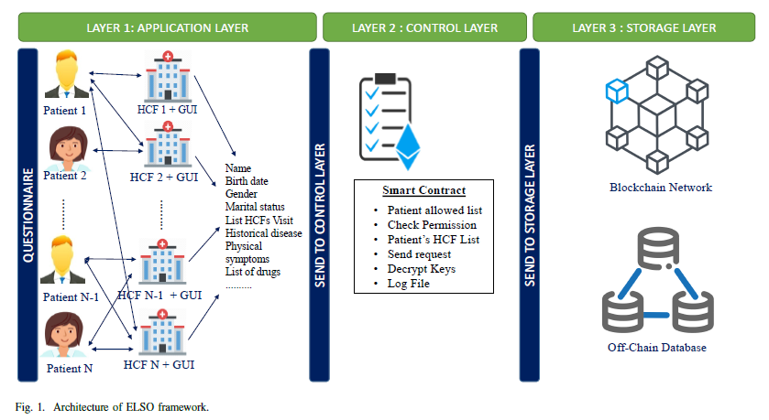
Journal - ELSO: A Blockchain-Based Technique for Efficient Healthcare Information Exchange
ELSO consisted of three layers (application, control and storage) with three security levels. The first layer is built into the original Ethereum blockchain while the second one resides in the SC and aimed to check if the clinician is in the allowed list and has the permission to access the patient data. The third layer was the splitting data process in which the patient information is divided into sensitive data, that are stored in the off-chain, and relative data, that are stored in the blockchain network. We showed the relevance of our mechanism through simulations on real health data where the obtained results outperform those obtained with other exiting techniques.

Slide 10
Thank you.
Joseph Merhej

